Slide 1
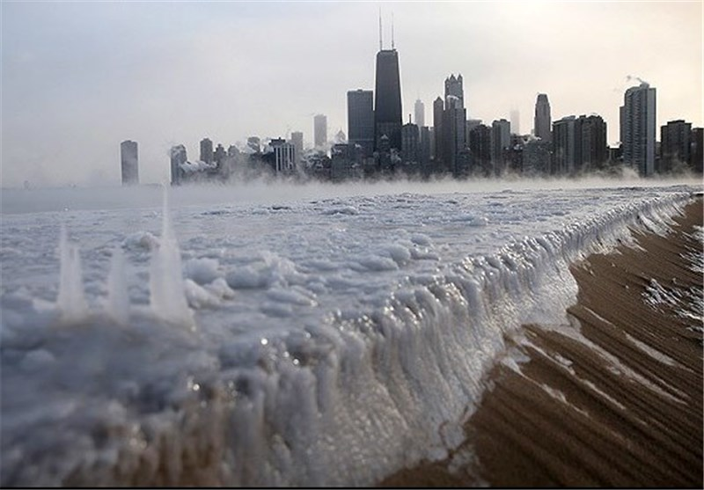
Texas Preparedness and Response to the 2021 Freeze
Contributors
Andia, Michael
Grice Hannah
Lipscomb Anthony
Mehta, Shraddha

Slide 2



Why Comparison
Extreme Weather Event States

Slide 3
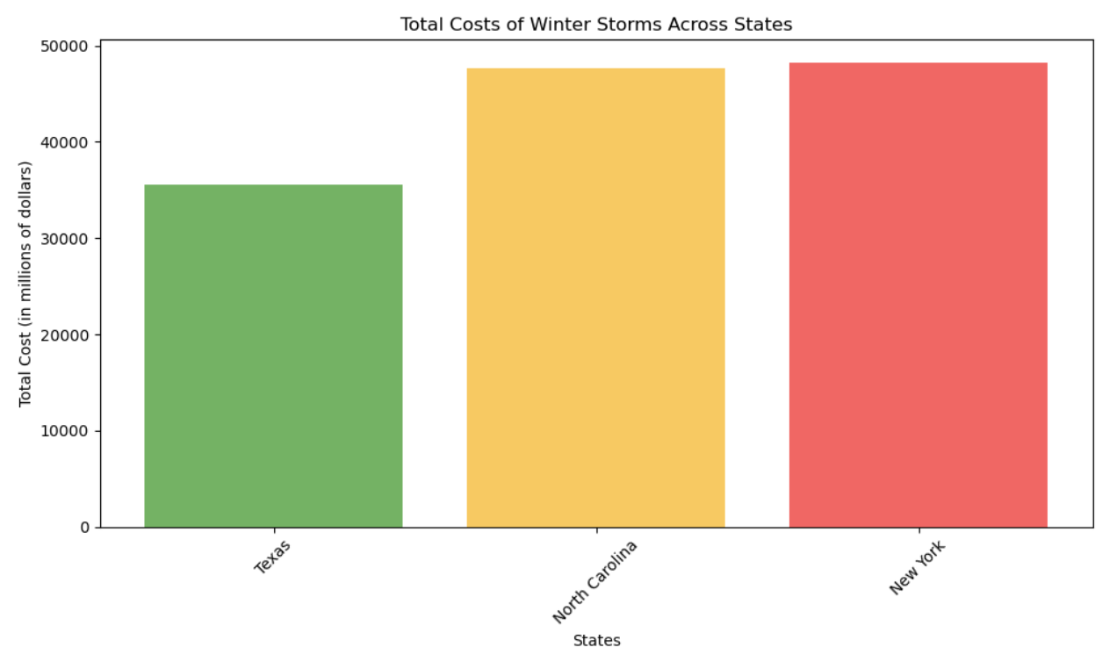
How we started…
Data is based on 10 year timeline 2014 - 2024
State with Maximum Winter Storms
North Carolina
State with longest Duration of Winter Storm
Texas (February 10, 2021 to February 19, 2021), 9 days
State with Maximum Total Cost on Winter Storms
New York (4.8 Billion Dollars)

Slide 4

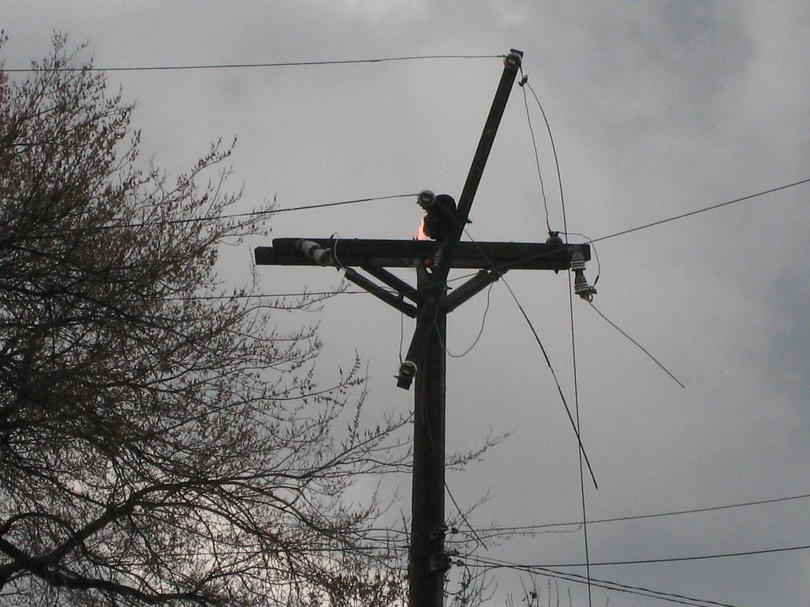


Preparedness of Texas in Comparison to Northeastern States
Parameters
Resiliency Score
Power Outages
Total Cost

Slide 5
Resilience Index:
The Climate Resilience Screening Index (CRSI) is a metric used to assess a state's ability to withstand and recover from climate-related challenges. The states included in this study were Texas, North Carolina, and New York.
The metrics that make up the Resilience Index include:
Risk
Governance
Build Environment (Infrastructure)
Natural Environment
Society
Importance of CRSI:
The CRSI is important because it provides insights into a region's preparedness.
It also helps policymakers prioritize resources to successfully manage extreme climate events.
Notes:
As Shraddha mentioned in the prior slide, Resilience is one of the Preparedness Parameters that we will be assessing. A states resilience index is defined by the Climate Resilience Screening Index (CRSI).

Slide 6
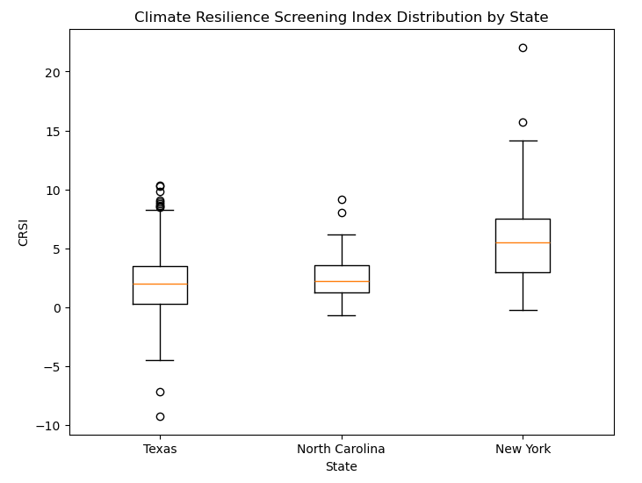
Data Analysis:
Performance statistics were assessed for each state.
Analysis of Variance (ANOVA):
Assessed differences in CRSI mean and standard deviation across Texas, North Carolina, and New York
Key Analysis Findings:
Significant variation was observed in CRSI values among the three states.
Mean CRSI Value by State:
Texas: 2.24
North Carolina: 2.54
New York: 5.99

Slide 7
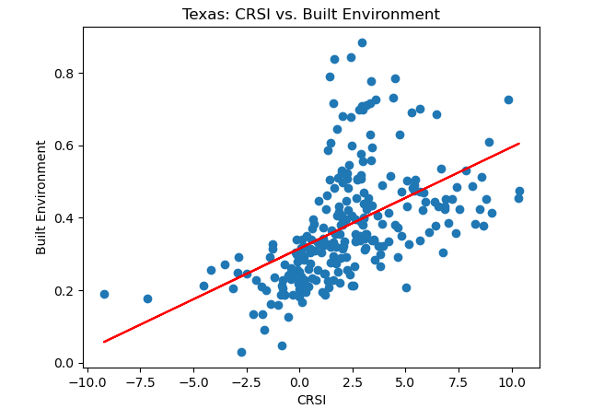
Regression Analysis:
With the focus on Texas, regression analysis was performed on a few of the key CRSI metric components: Risk, Governance and Built Environment.
Key Regression Findings:
Strong positive correlation between CRSI and Built Environment.
Statistical Significant difference observed in CRSI and Built Environment.
Weak negative correlation and minimal statistical significance was observed with Risk and Governance.
Notes:
With the focus on Texas, regression analysis was performed on a few of the key CRSI metric components.

Slide 8
Conclusion and Key Takeaways:
Conclusion:
Implications of CRSI leading to the 2021 Winter Storm-Uri
Texas's low CRSI score was a leading indicator of vulnerability to extreme weather events.
Lack of resilience infrastructure may have contributed to the challenges faced during the 2021 storm.
Key Takeaways:
Resilience planning and investment is critical to a state's ability to deal with extreme climate events.
The disparities in CRSI values between Texas, North Carolina, and New York underscores the importance of strong resilience strategy and planning.
There is an ongoing need for proactive measures to enhance resilience in the face of climate change events.
Notes:
Leading into the 2021 Winter Storm that Michael will speak about, Texas's low CRSI score was a leading indicator of vulnerability to extreme weather events.
Lack of resilience infrastructure may have contributed to the challenges faced during the 2021 storm.

Slide 9
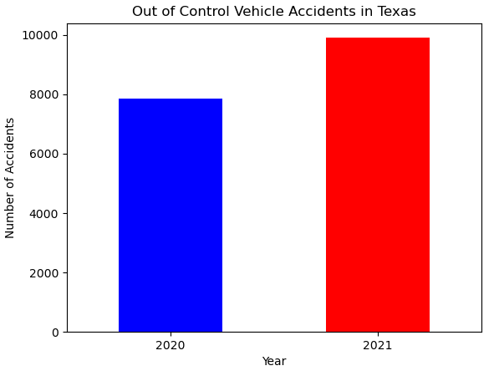
Hazards of Winter Storm Uri
Consumers Without Power in 2021: 1,153,456,237
Road Accidents Due to Loss of Vehicle Control 2021: 9,906
About 2,000 more accidents than in 2020
Total Cost: $26.8 Billion

Slide 10
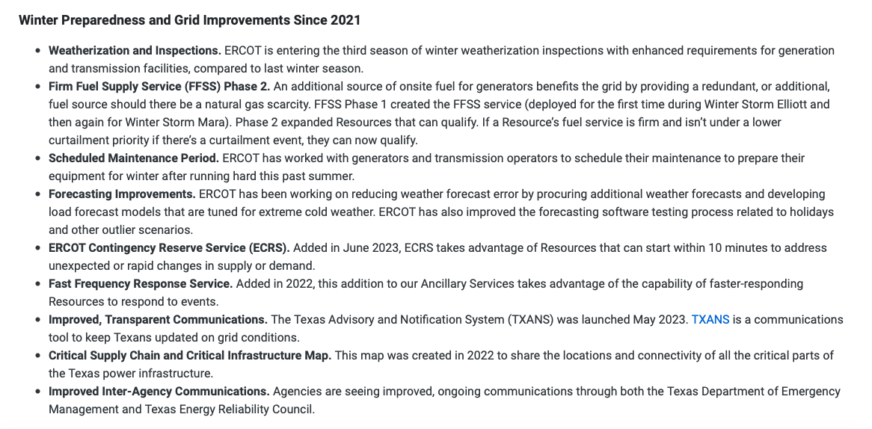
Ercot’s Power Grid Adjustments

Slide 11
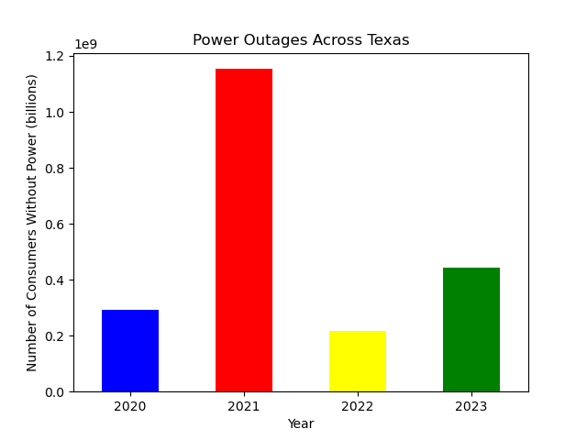
How Texas Responded in Following Years
Consumers without power dropped significantly
However, we can’t say for certain that the changes are because of Ercot’s adjustments
May be because of less severe temperatures

Slide 12
Limitations
Some data found does not directly correlate to the winters but to entire years
X (Twitter API). We were unable to pull past tweets that could really help us in learning how weak ercot communication system was.
Ercot Data - Communications related to grid operations, emergency response, and other critical matters may be subject to specific record-keeping requirements to ensure transparency, accountability, and regulatory compliance.

Slide 13
Conclusions
The Climate Resilience Screening Index (CRSI) highlights significant disparities in resilience among Texas, North Carolina, and New York, with New York leading with the highest CRSI score.
Texas's vulnerability to extreme weather events, as evidenced by its low CRSI score, underscores the critical need for resilience planning and investment.
Winter Storm Uri's devastating impact, including widespread power outages and substantial economic costs, accentuates the importance of proactive measures to enhance resilience.
Texas has made strides in reducing power outages post-Uri, indicating some improvement in response and recovery efforts.
Despite progress, limitations such as incomplete data and challenges in communication systems underscore the ongoing need for transparent, accountable, and robust infrastructure to address future climate-related hazards effectively.

Slide 14
References:
https://www.nature.com/articles/s41597-024-03095-5#Sec11
https://tableau.txdot.gov/views/CRISDashboardforTxDOT_gov/CRISCrashDataAnalysis?%3Aembed_code_version=3&%3Aembed=y&%3AloadOrderID=0&%3Adisplay_spinner=no&%3AshowAppBanner=false&%3Adisplay_count=n&%3AshowVizHome=n&%3Aorigin=viz_share_link#7
https://www.ercot.com/news/release/2023-11-17-ercot-cancels-procurement
https://www.ncei.noaa.gov/access/billions/events/TX/2021?disasters[]=freeze&disasters[]=winter-storm
https://www.ercot.com/news/release/2023-11-17-ercot-cancels-procurement

